Slide 1
Capacity Implications of PTC now and in the Future
David Thurston, Ph.D., P.E., FIRSE
Vice President – Rail Systems,
Parsons Transportation Group,
Philadelphia, PA
October 15, 2012

Slide 2
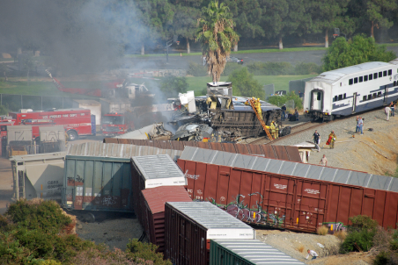
Capacity Implications of PTC now and in the Future
Why PTC?

Slide 3
Capacity Implications of PTC now and in the Future
FRA defines a PTC System as “integrated command, control, communications and information systems for controlling train movements with safety, security precision and efficiency”

Slide 4
Capacity Implications of PTC now and in the Future
For PTC, there are four approaches
Non Vital Overlay (NVO)
Vital Overlay (VO)
Vital Stand Alone (VSO)
Mixed (M)

Slide 5
Capacity Implications of PTC now and in the Future
With three commercial approaches:
ITCS, A proprietary system in service in Michigan (VO)
ACSES, An open system used in the Northeast developed by Amtrak (VO)
I-ETMS, A proprietary system (to be open in the future) being developed by the Class 1 Railroads (BNSF, UPRR, CSX, and NS) (VO)

Slide 6
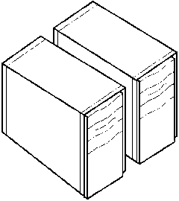

ITCS PTC
Computer Aided Dispatch
Communication
Network
Base Station
Backhaul: Fiber Optic, Microwave, Commercial, Telco
CAD
ROCS
RF Link
GPS
On-Board
Radio Block Controller
RF Link
Interlockings
Signals and Crossings
EIC
Transponders

Slide 7

ACSES PTC
Computer Aided Dispatch
& Back Office Server
Communication
Network
Backhaul: Fiber Optic, Microwave, Commercial Telco
Field Radio
CAD
Safety Server
220MHz Spectrum
Codec
On-Board
Interlocking
Wayside Interface Unit
Cab Signals
Transponders

Slide 8
I-ETMS PTC
Computer Aided Dispatch
& Back Office Server
Communication
Network
Backhaul: Fiber Optic, Microwave, Commercial Telco
Base Station
CAD
Location Reports/ Authorities
GPS
Codec
BOS
220MHz Spectrum
Cell Modem, WSRS
220MHz Spectrum
Cell Modem, WiFi
Wayside
EIC
Signal Status
220MHz Spectrum
On-Board

Slide 9
Capacity Implications of PTC now and in the Future
I-ETMS PTC Characteristics:
Slow start, legislated finish
Does not provide Interlocking functions
Under development
An Overlay
“Open Architecture”
Metrolink V/I Contract Value

Slide 10
Capacity Implications of PTC now and in the Future
Capacity Cases:
Dark Territory (TWC, Form D)
CTC/ABS (Wayside Only)
Cab Signals with Wayside signals
Cab Signals without Wayside Signals

Slide 11
Capacity Implications of PTC now and in the Future
Capacity Metric:
Following Move Headway
Head to Head Capacity
Civil Speed Capacity Impacts
Running Times

Slide 12
Capacity Implications of PTC now and in the Future
Stopping Distance
Stopping Distance
(Green)
(Green)
(Green)
(Green)
(Green)
(Yellow)
(Red)
(Yellow)
(Red)
Direction of Travel
In conventional wayside Train Control, train spacing is determined by fixed wayside signals

Slide 13
Capacity Implications of PTC now and in the Future
Lost Capacity
SBD Stopping Curve
SPEED
Performance Stopping Curve
DISTANCE
Signal Spacing is based on the Safe Braking Distance (SBD) with fixed blocks
SBD is generally conservative approach (Adhesion)
Adaptive Braking (PTC) needs to address this as well

Slide 14
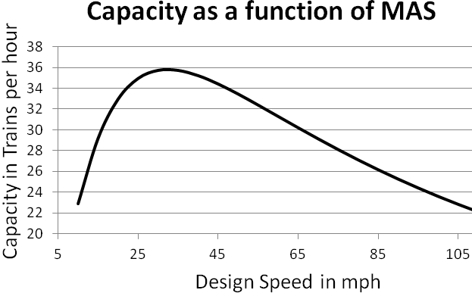
Capacity Implications of PTC now and in the Future
When block length is optimized around different operating speeds, capacity can be optimized.
During crush times
We get maximum
Capacity.
Idealized Capacity
Trains per Hour

Slide 15
Capacity Implications of PTC now and in the Future
Civil Speed Restriction are also enforced in PTC. These are not anomalies, and are present for all trains
Enforcement is provided through a reducing speed curve based on conservative principals similar but not as restrictive as stopping distance. This reduces capacity.

Slide 16
Capacity Implications of PTC now and in the Future
Performance Reducing
Curve
SPEED
Lost Capacity
Enforced Reducing
Curve
DISTANCE
Conservative braking algorithms cause enforced braking of trains before conditions warrant in some cases (Adhesion)

Slide 17
Capacity Implications of PTC now and in the Future
Adaptive braking (a proprietary algorithm)
Assumed inputs of braking forces, alignment, and power, with an assumed adhesion
Freight train braking means you only get “one shot” at a brake application. This makes system feedback of the parameters less useful.

Slide 18
Capacity Implications of PTC now and in the Future
 | Following Move Headway |  |  | Head to Head Capacity |  |  | Civil Speed Capacity Impacts |  |  | Running Times
 | ITCS | ACSES | I-ETMS | ITCS | ACSES | I-ETMS | ITCS | ACSES | I-ETMS | ITCS | ACSES | I-ETMS
Dark Territory | N/C | N/C | ↑ | N/C | N/C | ↑ | ↓ | ↓ | ↓ | ↑ | ↑ | ↑
CTC/ABS | N/C | N/C | ↓ | N/C | N/C | ↓ | ↓ | ↓ | ↓ | ↑ | ↑ | ↑
Cab w/ Wayside | ↓ | N/C | N/C | N/C | N/C | N/C | ↓ | ↓ | ↓ | ↑ | ↑ | ↑
Cab w/o Wayside | ↓ | N/C | N/C | N/C | N/C | N/C | ↓ | ↓ | ↓ | ↑ | ↑ | ↑
Results from PTC Installations
 | = Not Significant

Slide 19
Capacity Implications of PTC now and in the Future
The Future
The conversion of PTC into a Vital Standalone Train Control System will allow for significant advances in areas of:
Business Applications,
Increased safety, and
Increased capacity

Slide 20
Capacity Implications of PTC now and in the Future
Stand alone means eliminating the underlying fixed signal blocks present in conventional signaling. This is replaced by a Moving Block that is tied to the rear of the train.

Slide 21
Capacity Implications of PTC now and in the Future
Braking Distance to Stop for Following Train
Train Speed
Distance
For true moving block, Minimum Headway is solely determined by their adaptive braking distance from current speed

Slide 22
Capacity Implications of PTC now and in the Future
 | Following Move Headway |  |  | Head to Head Capacity |  |  | Civil Speed Capacity Impacts |  |  | Running Times
 | ITCS | ACSES | I-ETMS | ITCS | ACSES | I-ETMS | ITCS | ACSES | I-ETMS | ITCS | ACSES | I-ETMS
Dark Territory | N/C | N/C | ↑ | N/C | N/C | ↑ | ↓ | ↓ | ↓
CTC/ABS | N/C | N/C | ↓ | N/C | N/C | ↓ | ↓ | ↓ | ↓
Cab w/ Wayside | ↓ | N/C | N/C | N/C | N/C | N/C | ↓ | ↓ | ↓
Cab w/o Wayside | ↓ | N/C | N/C | N/C | N/C | N/C | ↓ | ↓ | ↓
↑
↑
↑
↑
↑
↑
↑
↑
↑
↑
↑
↑
Stand Alone Application | ↑ | ↑ | ↑ | N/C | N/C | N/C | ↓ | ↓ | ↓
↑
↑
↑
Results from PTC Installations
 | = Not Significant

Slide 23
Capacity Implications of PTC now and in the Future
Thank You

